Slide 1
Helping your child to stay safe and thrive in the modern world
Laughton Primary and Firle CEP Schools - together the Oak Tree Federation
Notes:
Welcome parents: Thank you for attending today, you are experts on your children and we are keen to hear your views as much as we are to share what is planned at (both Firle and Laughton Schools)
Introduce staff present – ensure that the PSHE lead is introduced if not presenting, as well as any teachers that are involved in the delivery of PSHE who are present
Talking to children/young people about challenging issues is not always easy, but it is essential that we build good communication skills from an early age to reduce risk taking behaviours later on, and to teach the skills to manage risk and promote the skills to live safely and thrive in the modern world.

Slide 2
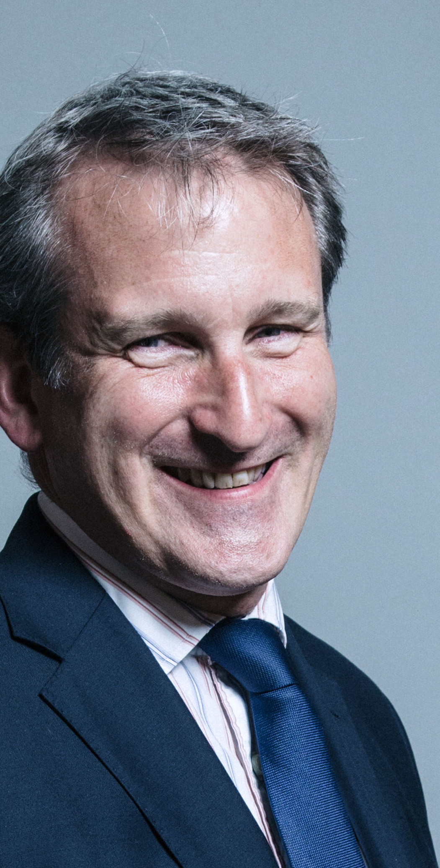
Secretary of State Foreword
“Today’s children and young people are growing up in an increasingly complex world and living their lives seamlessly on and offline. This presents many positive and exciting opportunities, but also challenges and risks. In this environment children and young people need to know how to manage their academic, personal and social lives in a positive way”.
Contains public sector information licensed under the Open Government Licence v3.0
Notes:
Explain to parents that this is the rationale for statutory RSE. Safe, happy, healthy children/young people
If time allows/small group as them to discuss/draw around a stick person to identify the ‘challenges’ and ‘risks’

Slide 3
Children and young people see…
Notes:
[Click links to visit current image search results - copyright restrictions prevent embedding images in presentation.]
We are going to start by reminding ourselves about some of the things that our children/young people are exposed to...
You may not have these magazine and computer games in your home, but your child may still see things like this in shops, other people’s homes etc.
From June 2019, under new rules, British companies will no longer be able to create promotions that depict men and women engaged in gender-stereotypical activities, amid fears that such depictions are contributing to pay inequality and causing psychological harm.
Adverts will no longer be able to show a person failing to achieve a task specifically because of their gender, such as a man unable to change a nappy or a woman unable to do DIY/park a car.
The rules will also ban adverts that suggest that transforming your body will make you romantically successful, while also clarifying rules on the sexualisation of young women.

Slide 4
Little Red Riding Hood?!
Notes:
World Book Day example…
Accidental exposure – still has an influence and impact of body image, self –esteem, behaviours, norms etc

Slide 5
Children and young people hear…
“Photograph with no T-shirt on.”
“I been googling ways to keep you entertained.”
“I can't help imagining all the things we'd do, with no clothes on.”
“Cause me one, you there's a million and they all wanna huh my Brazilian.”
Little Mix Lyrics
Image: InfoGibraltar
Notes:
The image and lyrics are from Little Mix.
There are more sexualised artists and lyrics, but we are sharing Little Mix as they are often thought of as a young person friendly group, yet their lyrics reference some risk taking behaviours and suggest sexual norms inc. sexting, watching pornography and the removal of pubic hair. Whilst some lyrics may not be understood by all children, they can still subconsciously absorbed.

Slide 6
Children and young people access…
Bullying
Fake news
Grooming
Sexting
Curious/purposeful seeking out of age inappropriate material
Extremism
Notes:
Children and young people are sometimes allowed on social media sites at home, round friends houses, grandparents houses and in public places. Not all of these have the same privacy settings and security features that are set up in your home. Young people are sadly at risk of all the things listed on this slide.
It would be helpful to have completed a pupil survey, even if it is an informal one to ask pupils what social media issues (inc. those listed on the slide) that they have experienced, or know someone who has experienced. This will provide parents with some data relevant to their children.
Primary/Junior schools – Show ‘bedtime stories’: https://www.youtube.com/watch?v=hrrhP68fYJ0

Slide 7
Children and young people are affected by the sexualisation of society and media influences
Children are as likely to stumble across pornography by accident as to search for it deliberately
More boys view pornography through choice than girls
Young people report feeling disturbed by what they have seen.
NSPCC, 2016
Getty Images
https://www.mdx.ac.uk/__data/assets/pdf_file/0021/223266/MDX-NSPCC-OCC-pornography-report.pdf
Notes:
Young people are affected by the media messages they see on TV, in music lyrics and videos, magazines, computer games, exposure to pornography etc. This can influence their self-esteem, body image, ideas about gender etc. It can be helpful to discuss with your child what they should do if they come across something online that they do not want to see, or that gives them cause for concern.

Slide 8
Your children want to learn…
More about their changing bodies and about puberty
Notes:
Activity: Post-it note, what do you want your children to learn in RSHE

Slide 9
What do you remember about your sex education from school/home?
Notes:
Ask parents, if they feel comfortable, to discuss with the people they are sat next to, or to personally reflect on their own memories of the relationships and sex education they had as they were growing up. Ask them if it prepared them, in terms of information, skills, values and attitudes for their bodily changes and personal relationships.
Research repeatedly highlights that relationships and sex education is still not meeting the needs of children and young people. Without accurate information, taught sensitively young people are not being provided with adequate opportunities to enjoy healthy and safe relationships in the modern world. The government has recognised and responded to this research, and is making RSE a statutory part of the school curriculum in all schools from September 2019.

Slide 10
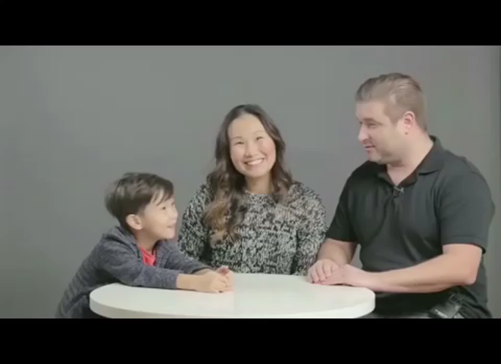
Conception misconceptions!
Resource Example – Cut: The Birds and the Bees - Parents Explain
https://www.youtube.com/watch?v=a3MyLt6l5n0
Notes:
Show if you have time. It is great for lightening the mood [Copyright restrictions prevent embedding videos in presentation] !
An example resource can be found at - The Birds and the Bees | Parents Explain | Cut https://www.youtube.com/watch?v=a3MyLt6l5n0
Highlight that the challenge for teachers is that children arrive with a number of misconceptions. These can continue into teenage years where misconceptions are compounded by media, inc. pornography.

Slide 11
Our school vision for RSHE is….
to find a good balance in preparing children for their future, while still valuing their childhood. We aim to give children the information they need, at a time which is appropriate. We aim to give them a safe environment and platform to ask questions and explore life in order to become well-rounded and caring individuals.

Slide 12
Our schools’ overarching aims and objectives for pupils is
to inspire learning for life (‘Life in all its fullness’ – John 10:10 at Firle CEP). Our RSHE policy is written with this in mind, and aims to give children the tools they need in their life’s journey; to support and prepare them for what they might encounter along the way.

Slide 13
RELATIONSHIPS EDUCATION: Schools will be required to teach…
Families and people who care for me
Caring friendships
Respectful relationships
Online relationships
Being safe
Notes:
PRIMARY
Explain, that after the presentation they will be provided with an opportunity to see the full spiral curriculum, and some of the resources that are being used to deliver the lessons.
Teaching Icon ©MS PPT

Slide 14
HEALTH EDUCATION Schools will be required to teach…
Mental wellbeing
Internet safety and harms
Physical health and fitness
Healthy eating
Drugs, alcohol and tobacco
Health and prevention
Basic first aid
Changing adolescent body
Notes:
PRIMARY AND SECONDARY
Highlight that mental wellbeing forms an integral part of many of the lessons.
Parents have no right to have their child excused from any of these lessons.

Slide 15
Naming body parts
Anus: The private part of the body where poo comes out
Penis: The private part of a boy where wee comes out
Vulva: The private part of a girl that she wipes when she has had a wee
Notes:
PRIMARY
It is essential to have a common language within the classroom, and for schools to impart accurate information to children.
These are how the words will be described to children.

Slide 16
Puberty as part of Health Education
Key facts about puberty and the changing adolescent body, particularly from age 9 through to age 11, including physical and emotional changes.
About menstrual wellbeing including the key facts about the menstrual cycle.
Puberty should be covered in Health Education and should be addressed before onset so, as far as possible, pupils are prepared in advance for changes they will experience.
Contains public sector information licensed under the Open Government Licence v3.0
Notes:
PRIMARY
Parents can not withdraw their child from these lessons.

Slide 17
Sex Education
Ensure boys and girls are prepared for changes of adolescence
Draw on knowledge of human life cycle in the NC for science – how a baby is conceived and born
The Department continues to recommend that all primary schools have a sex education programme tailored to the age and the physical and emotional maturity of the pupils.
Contains public sector information licensed under the Open Government Licence v3.0
Notes:
PRIMARY
Teaching about how a baby is conceived and born, taught outside of national curriculum for science is the only part that parents are able to withdraw their child from.
Should this be your wish, whilst your request will be automatically granted in the primary phase. Before the head teacher can grant your request they are required to meet with you in person to discuss the nature and purpose of the curriculum, and where appropriate the wishes of your child. The benefits of receiving this important education and any detrimental effects that withdrawal might have on the child. This could include any social and emotional effects of being excluded, as well as the likelihood of the child hearing their peers’ version of what was said in the classes, rather than what was directly said by the teacher.
Schools are required to document the conversation to ensure a record is kept.
Good practice is also likely to include the head teacher discussing with parents

Slide 18
Statutory requirements
Schools have to teach biological aspects of human growth and reproduction within National Curriculum Science.
From September 2020, all schools will have to teach Relationships Education, Relationships and Sex Education and Health Education.
Equalities Act, 2010
Safeguarding
British Values
Spiritual, Moral, Social and Cultural
Notes:
Schools have a number of statutory requirements that they have to teach.

Slide 19
Teaching about LGBT
The needs of all pupils must be appropriately met, and that all pupils understand the importance of equality and respect.
LGBT content is fully integrated into the curriculum
All pupils to have been taught LGBT content at a timely point as part of this area of the curriculum
Build a culture through positive action, where homophobia and gender stereotypes are not tolerated.
Notes:
Schools are required within the new RSHE guidance to have covered relevant LGBT content, in an integral way at a timely point.
Schools are legally required to ‘protect’ (not promote) all of the protected characteristics, which include gender, sexuality and gender reassignment.
May be helpful to reference:
Equalities Act, 2010 –PSED
CE School – valuing all gods children guidance

Slide 20
All families are welcome, safe and included in our school
https://www.amazon.co.uk/Tango-Makes-Three-Justin-Richardson/dp/1847381480
https://www.outforourchildren.org.uk/resources/
Notes:
PRIMARY
Legislation references diverse families, including composition and dynamic (LAC/Young carers)

Slide 21
How our school will teach this…
Each class will create a working agreement so pupils feel comfortable to join in the lessons;
All teachers will use correct scientific language when talking about parts of the body;
No pupil will be forced to join in an activity, or answer a question;
All genders taught together;
Teachers have been trained to teach these lessons;
Teachers are unlikely to, and pupils not be asked to share personal experiences;
All causes for concern raised as a result of the lessons will be dealt with according to the school safeguarding policy.
Notes:
Discuss any other factors relevant to the approach or delivery of RSE teaching at the school. For example, sensitive to faith perspectives

Slide 22
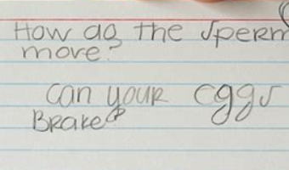
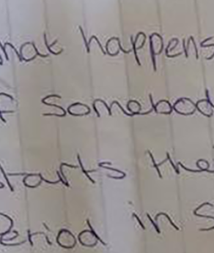
How questions will be answered…
What is a ‘twink’?
How does the sperm crack the egg?
How do two men have sex?
What is rape?
Can I get condoms without my parents finding out?
Getty Images
Notes:
Throughout the lesson, and at the end of the lesson pupils will be provided with an opportunity to ask questions. They may do this with the whole class, during an end of the lesson Q&A session, and through an anonymous ‘ask it basket’. Pupil questions are the part of the lesson that is hard for the teacher to plan and prepare for, as we can not anticipate every question that will be asked. It may be that a teacher will make the decision not to ask a question and will work with your child to explore safe sources of information, such as asking at someone at home.
Explain to parents how questions may be answered, including sharing some examples of ‘typical’ questions and example answers.

Slide 23
Talking about puberty and sex
Use everyday opportunities
Be calm and relaxed
Really listen
Notes:
RSE will be taught according to statutory requirements, and inline with the ethos of the school and the framework of the school PSHE policy. It is important that as a family you take the time to share your personal values, beliefs and attitudes to the topic and also to create strong channels of communication with your child as early as possible. NHS choices has some helpful advice about talking to your child about their changing body, puberty and sex.
Signpost parents to other relevant sources of support, including any the information that we recently put on the website

Slide 24
Talk about body image and self-esteem
Dove Self-Esteem Project
Notes:
Help prepare your child to overcome low self-esteem and increase body confidence during adolescence.
Dove Self-Esteem project has some good resources for parents - https://www.dove.com/uk/dove-self-esteem-project.html

Slide 25
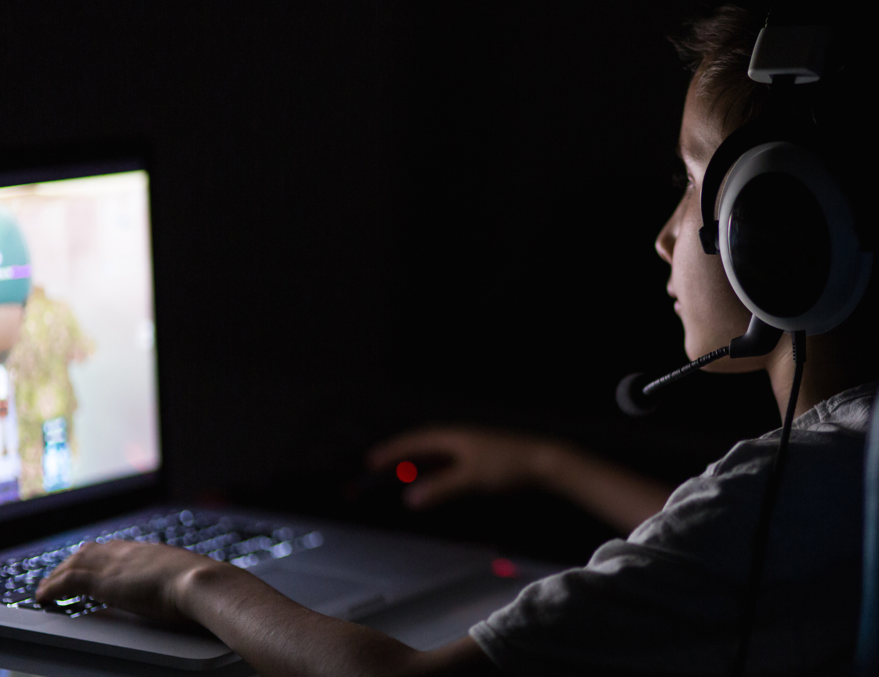
Talk about staying safe online
Getty Images
https://www.net-aware.org.uk/
https://www.vodafone.co.uk/mobile/digital-parenting
Notes:
Being aware of everything your child does online is hard, but checking their browsing history, covering the webcam and talking to them about the importance of online safety may help to reduce risk. Vodaphone digital parenting has some helpful advice and you may find it helpful to look at their website or download the latest copy of their Digital Parenting magazine (FREE)
PIR, POS - do you know what these mean?
Explain that you understand the internet is a great place to be and that you're just looking out for them. Tell them they should speak up and not keep secrets if something is worrying them.
Reassure them that you're interested in all aspects of their life. Say that you'd like to talk about stuff they've seen online, sites and apps they visit, and that you'll share the things you've seen too. Recognise that they'll be using the internet to research homework, for example.
Explain that you understand the internet is a great place to be and that you're just looking out for them. Tell them they should speak up and not keep secrets if something is worrying them.
Reassure them that you're interested in all aspects of their life. Say that you'd like to talk about stuff they've seen online, sites and apps they visit, and that you'll share the things you've seen too. Recognise that they'll be using the internet to research homework, for example.

Slide 26
These subjects represent a huge opportunity to help our children and young people develop. The knowledge and attributes gained will support their own, and others’, wellbeing and attainment and help young people to become successful and happy adults who make a meaningful contribution to society.
Contains public sector information licensed under the Open Government Licence v3.0

Slide 27
If you would like to discuss the RSHE provision further, please: Email: jgroves OR rwest@firle-school.e-Sussex.sch.uk
Notes:
Invite parents to ask questions. Answer as appropriate for your school setting. Remember: It is OK not to know the answer to every question, you can offer to discuss as a school and respond by the end of next week.
Thank parents for attending and invite them to explore the resources that you have made available and encourage them to ask questions on a 1:1 basis if they prefer.
Highlight contact information if they wish to have their child withdrawn from sex education taught outside of science curriculum.

